Slide 1
Photo Project

Slide 2
Problem
I run a small clothing brand Dog Park Daywear and getting studio quality photography is very expensive and takes a long time.
I’ve been searching for AI tools and products to replace hiring photographers but most have overlooked this problem and are more focused on lifestyle images, model images or ads.
An even bigger problem is most products/tools, including ChatGPT image generation hallucinate my logos and designs.

Slide 3
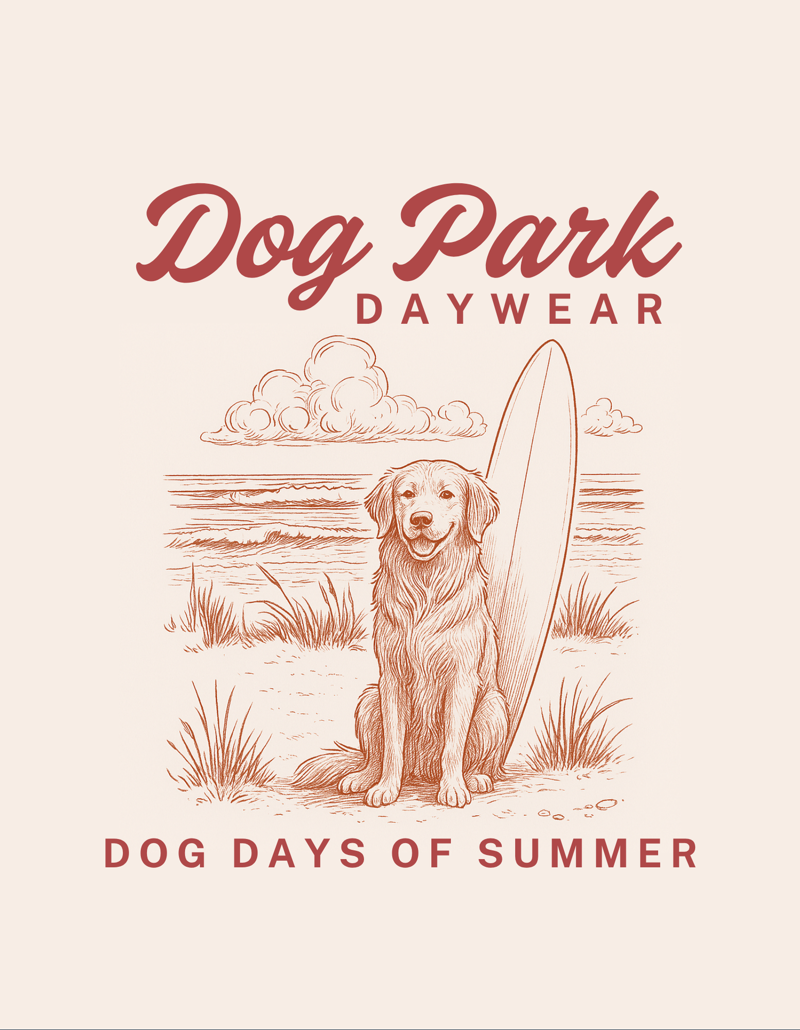
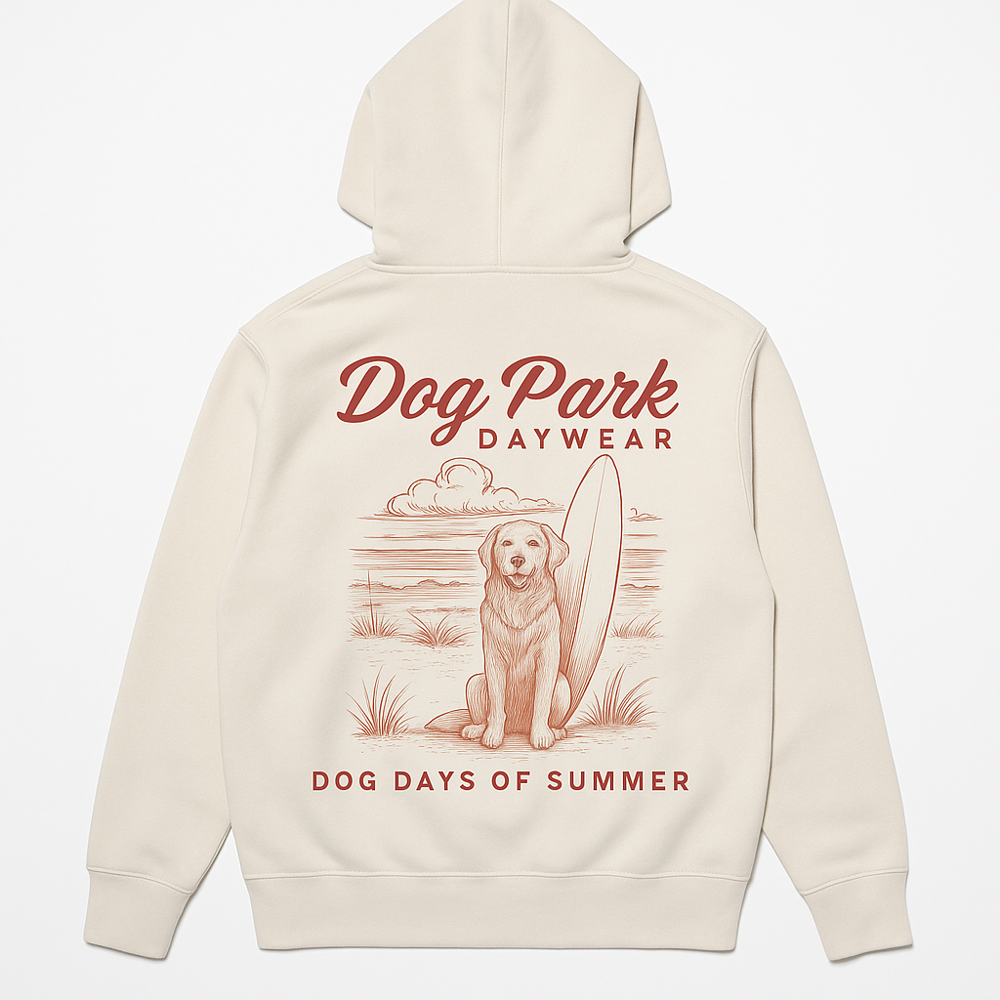
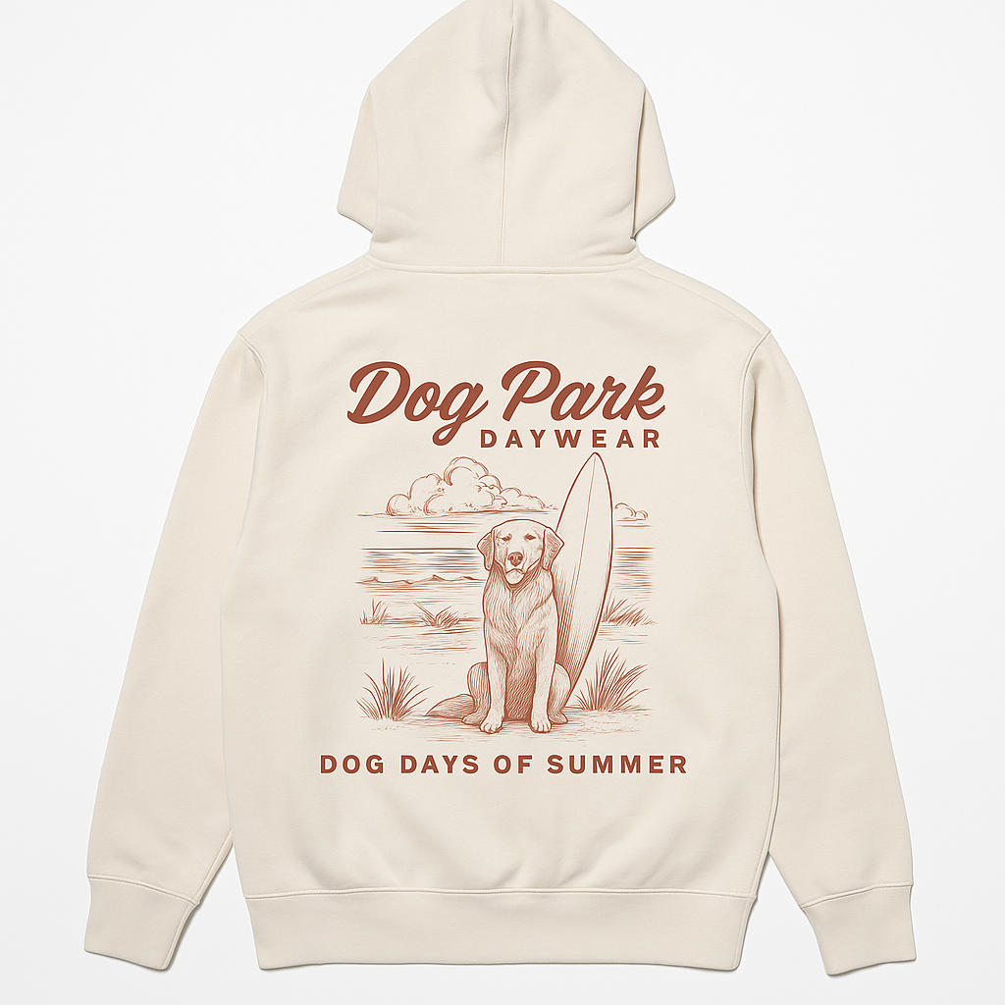
Problem Illustrated
This showcases the current issue with AI. Right now it hallucinates logos and designs which is very problematic for a clothing brand.

Slide 4
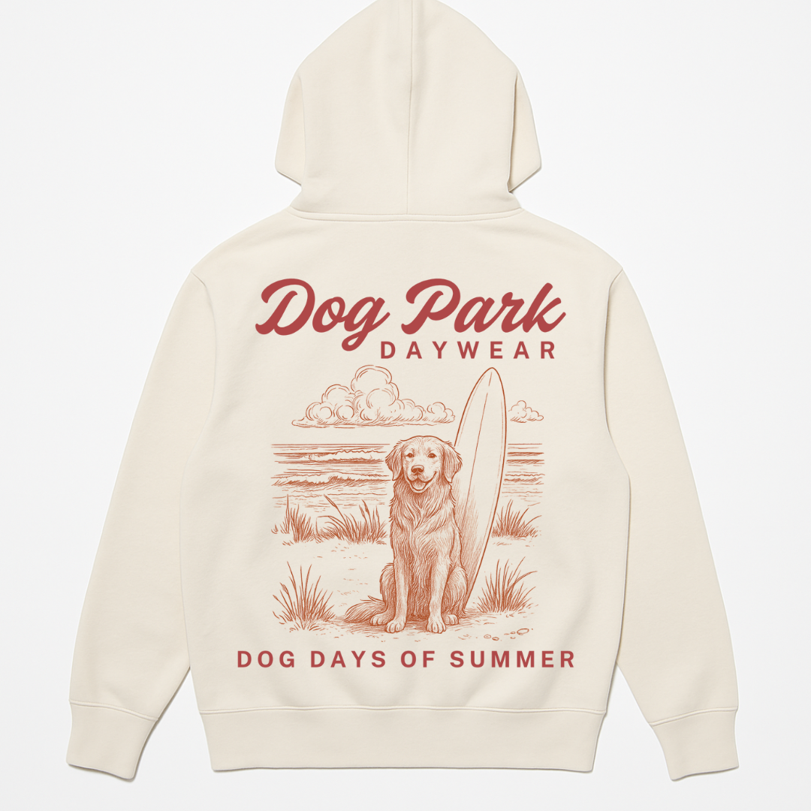
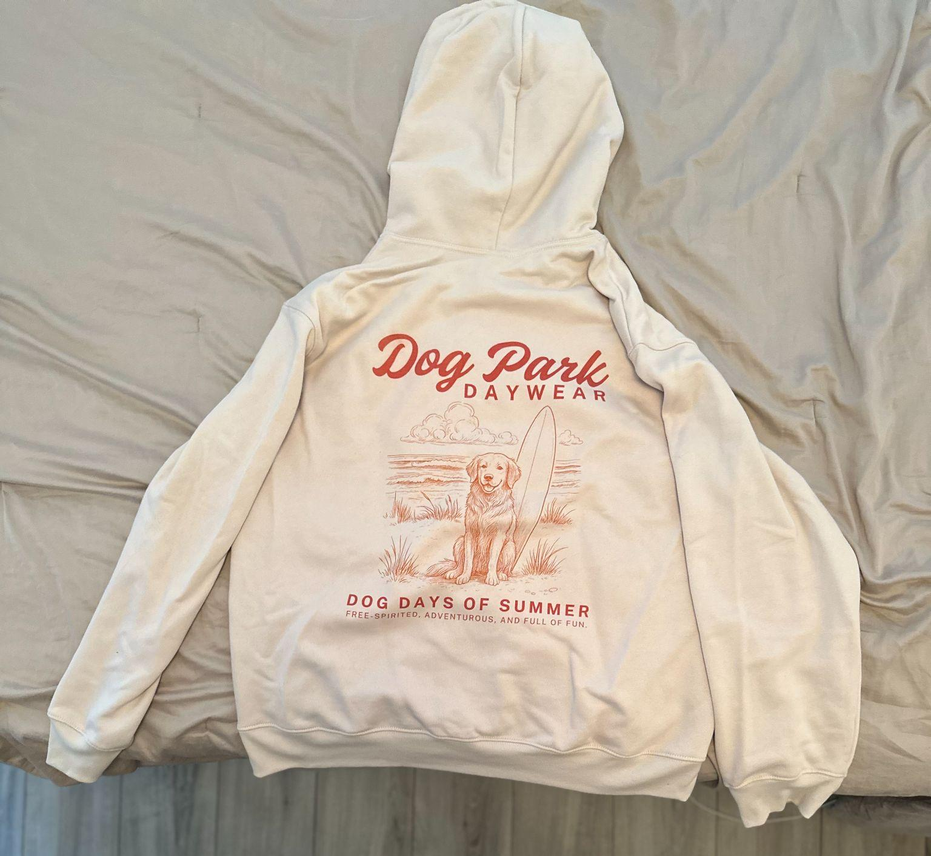
Ideal Solution
Simply add photo of product from cell phone and AI transforms into a studio quality photo without hallucinating logo/design.

Slide 5
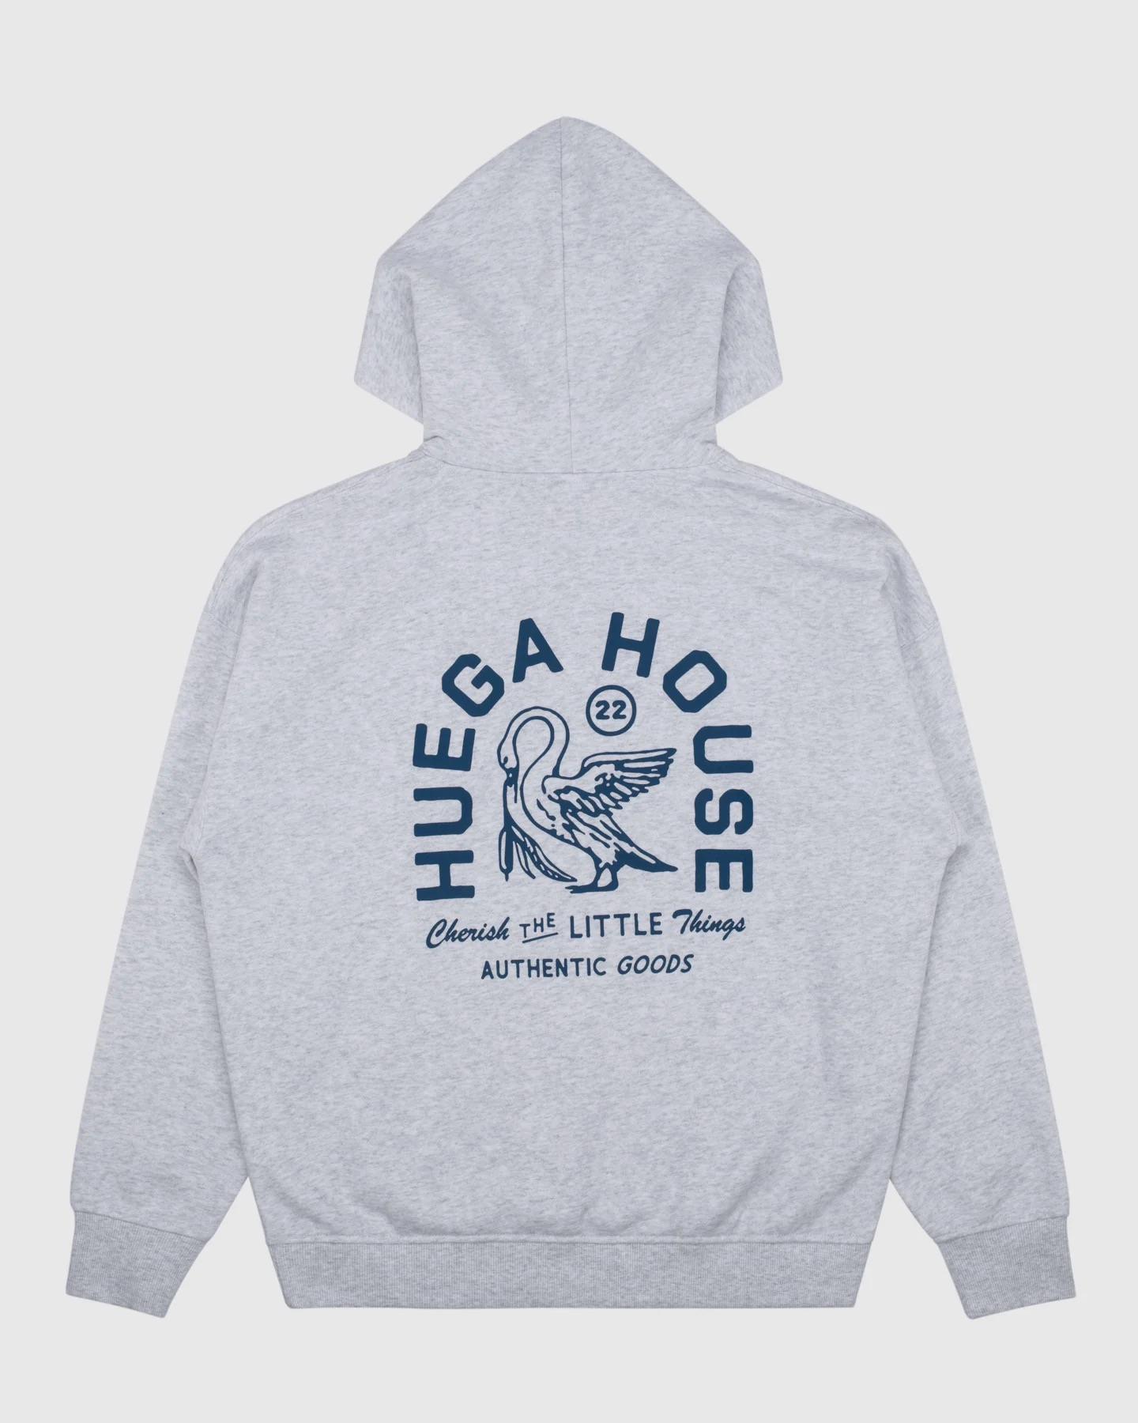
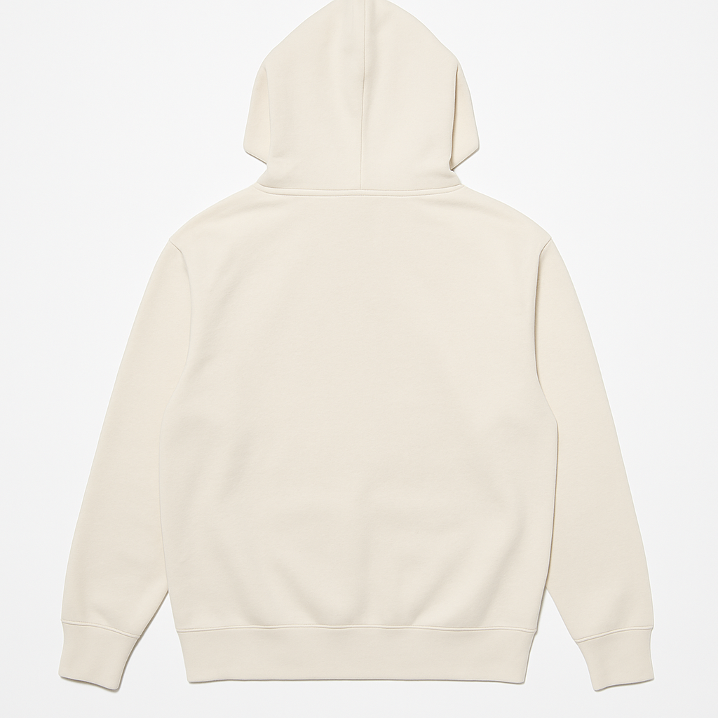
Current Solution
Step 1
Step 2
Step 3
I found that ChatGPT is good at creating photography of my product without the design and matching style using reference. Then I add my design file to the image in Canva.
Take Photo with Cell Phone
Use ChatGPT to create blank product photo and background using reference image
Use Canva to add design to back

Slide 6
Model & Site MVP
Looking to work hire someone who can:
Create the model that can automate this process using AI.
Build Web App that brings this model to the masses. Focused on a simple, intuitive UI/UX.
V1 MVP Features:
Upload a Photo of a Product: User uploads from their phone or desktop — ideally mobile-first design.
Add a Logo or Design Overlay: Drag and drop or upload functionality for .PNG or .SVG.
Choose or Upload a Background Image:
Option 1: Pick from a set of seamless reference backgrounds
Option 2: Upload your own background for AI to match style/lighting
Choose File Specs: choose from a selection of options 1080x1080, 1920x1080, 1080x1920, 1080x1350, create custom size
Optional Field for Notes or Direction: A single-line text field, but we may leave this out of V1 to keep it simple.
Would also need create simple one-page site that clearly communicates what the product does and encourages sign-ups or early access. The page should include: how it works, before/after slider, comparison vs. alternatives, gallery of examples, pricing. I like the simplicity of Reelfarm and can use as a reference.

